Slide 1
A Practical Guide to Organizational Change:
Inter-Agency Collaboration and Implementing Evidence-based Practices
15th Annual Statewide Conference
Disruptive Innovations and Sustaining Change
Wednesday, October 24, 2018
Universal City, CA
Michael S. Shafer, PhD
Beth Rutkowksi, MPH

Slide 2
Facilitating patient change is an essential skill of effective behavioral health care.
Facilitating organizational change is an essential element of implementing evidence-based practices and other practice improvement strategies.

Slide 3
Learning Objectives
Skills and techniques for facilitating implementation and process improvement teams.
Appreciation for the diversity in culture and values when working in multi-sector teams.
Compare and contrast effective group decision making & conflict resolution strategies.

Slide 4
part I: implementation
& process improvement

Slide 5
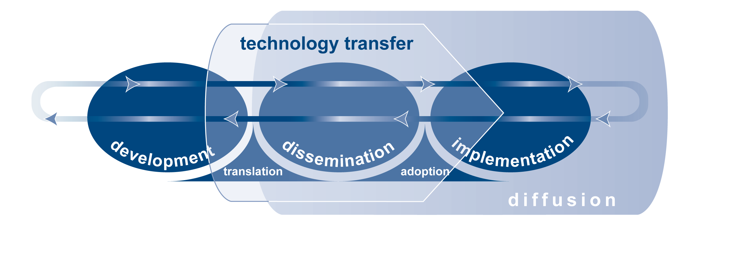
Technology Transfer, Diffusion, Dissemination, & Implementation
technology transfer
A multi-dimensional process that intentionally promotes the transfer of new innovations, knowledge, technologies, practices, and/or skills from one setting to another (i.e., from research to practice). This process begins during the development of an innovation, continues through its dissemination, and extends into its early implementation.

Slide 6
Technology Transfer, Diffusion, Dissemination, & Implementation
dissemination
An active process of spreading information and knowledge about an innovation with an expectation that it will be used in decision making processes and practice.
diffusion
A passive process by which information about an innovation may spread from the originators of the innovation to others.

Slide 7
Technology Transfer, Diffusion, Dissemination, & Implementation
implementation
A range of purposeful strategies designed to address individual, organizational, and systemic issues associated with incorporating an innovation into routine practice. These strategies can include staff selection, pre-service and in-service training, ongoing consultation and coaching.

Slide 8

5 Principles
Understand and involve the customer
Fix key problems
Pick an effective Change Leader
Get ideas from outside the organization
Use rapid-cycle testing
4 Aims
Reduce Waiting Times
Reduce No-Shows
Increase Admissions
Increase Continuation Rates

Slide 9
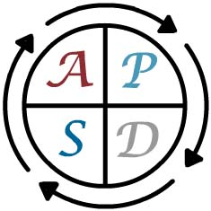
  Plan the change
  Do the plan
  Study the results
  Act on the new knowledge
    Adapt
    Adopt
    Abandon
9
Notes:
9
Standard slide – please do not modify.
Pick a concrete example of a PDSA cycle and walk the audience through the story.
Example:
Plan: An agency decides to offer walk-in service on Wednesday afternoons
Do: The agency offers the walk-in hours on Wednesday afternoon for two weeks.
Study: No clients showed up for service during the walk-in hours—because the agency forget to notify their community that they were open for walk-ins.
Act: Adapt by continuing to offer walk-ins and by advertising the walk-in hours to their community.
Emphasis on short cycles—two or three weeks at the most.

Slide 10
Process Improvement
Changes that Result in Improvement
A
P
DATA
S
D
D
S
P
A
A
S
P
D
A
P
S
D
Hunches Theories Ideas
  SOURCE: Langley, Nolan, Nolan, Norman, & Provost. The Improvement Guide, San Francisco, Jossey-Bass Publishers, 1996
10
Notes:
10
Standard slide – please do not modify.

Slide 11
Culture of Health Framework

Slide 14
Sectors that Patients with Substance Abuse May be Engaging
ED/ER
Detox
Primary Care
Psychiatry
Police
EMS
Courts
  Drug/DUI Court
  DV Court
Housing/HUD
Employment

Slide 15
sequential intercept model
Systems & Tools
Crisis Intervention Team Training
Mental health courts
In-jail healthcare services
Jail/prison release and re-entry
Settings
Police Depts.
Courts
Jails/Prisons
Hospitals
Outpatient Clinics
ED/Urgent Care Centers
Parties
County Prosecutors
Public Defenders
Peer Support Specialists
Case Managers
Psychiatrists/Psych. Nurses
Primary Care Physicians
Probation & Parole Officers
Emergency Room Physicians
Psychologists, Counselors

Slide 16
Areas of Multi-Sector
mis-Alignment
Culture
Values
Language & Nomenclature
Resources
Indicators of Success

Slide 17
part 2: change teams

Slide 18

change teams
A change team is (ideally) a group of individuals from several agencies, across multiple disciplines and various organizational levels, working together to complete one or more tasks toward a shared goal or objective.
(Allen, Foster-Fishman, & Salem, 2002; Hackman & Wageman, 2005; Rycroft & Malone, 2004)
Notes:
Similar to a steering committee, action committee, etc. but actively engaging in and responsible for change

Slide 19
Tuckman’s Stages of Group Development

Slide 20
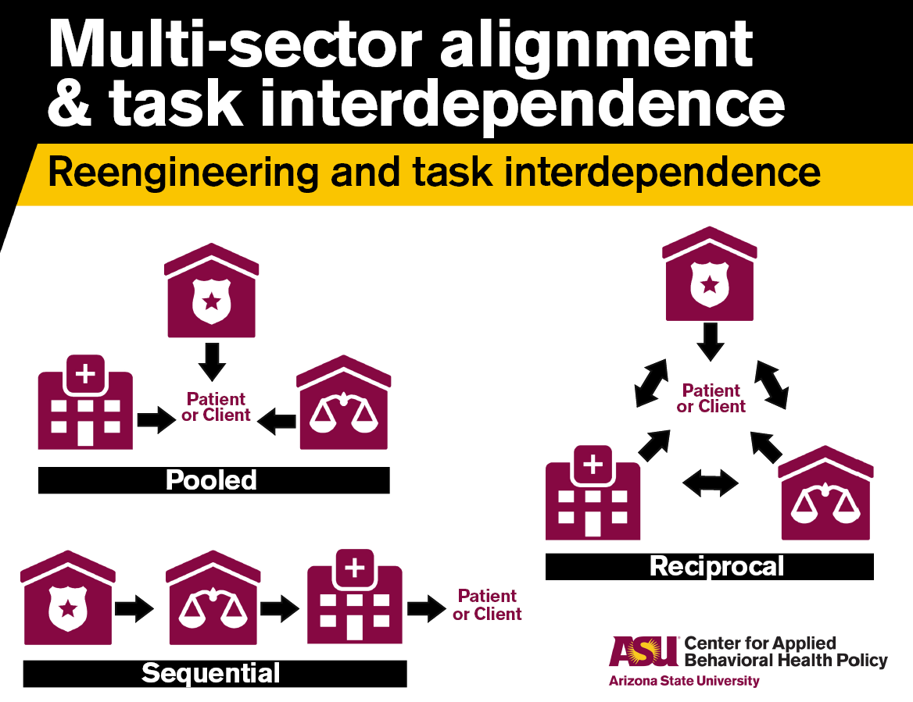
Intra-Agency v.
Inter-Agency Change Teams

Slide 21

change team leader
The Change Team Leader is a leadership position within the change team who facilitates change team communications alongside the external facilitator, and maintains ongoing engagement and briefing of agency executive leadership.
Notes:
Ideally a change team is co-facilitated by an internal change team leader (co-chairing for multiple agencies also acceptable) and external facilitator

Slide 22
external facilitator
The person who enables a group to work more effectively in the process of undergoing organizational or inter-organizational change.
The external facilitator provides
structure, focus, and direction for the group, while enabling group decision making and maintaining focus on tasks and the process of change.
(Loftus-Hills & Harvey, 1999; Kitson et al., 1998)
Notes:
External facilitator provides the benefit of neutrality & objectivity
Can also carry the load/lift when agency staff cannot (e.g. report writing, minutes documentation, etc.)

Slide 23

agency champions
Champions or opinion leaders are individuals within an agency who have the ability to influence others’ attitudes and behaviors towards the change objective due to their status or knowledge within their agency.
(Greenhalgh, Robert, Macfarlane, Bate & Kyriahkidou, 2004; Kitson, Harvey, & McCormack, 1998)
Notes:
Don’t want to fill an interagency change team with those who are ‘voluntold’
Who stands out as passionate? Informed? Willing to make the time? Who is well respected by their peers?
If they don’t have the support/faith of the organization (particularly line staff) may not be effective

Slide 24
change team leader role
generating goals to address needs
identifying organizational needs
communicating change
assigning tasks
prioritizing goals
implementing goals
identifying problems
creating timelines

Slide 25
team member characteristics
strong communication skills
interest
availability
tenure
organizational influence
voluntary participation
subject matter experts
strong relational skills

Slide 26
facilitator role
establishing trust
resolving conflict
team motivation
balancing agendas
focus
accountability
ensuring fairness
identifying good goals
gentle reminders
Notes:
Benefits of an external facilitator
Balancing agendas: Assisting agencies with different goals and different lenses find common ground
Gentle reminders: ‘if you recall you said you would do x, is that still feasible?’

Slide 27
MATICCE
Medication
Assisted
Treatment
In
Community
Corrections Environments

Slide 28
{
community corrections
MAT providers
external facilitator
pharmacotherapy exchange
council (PEC)
Notes:
This is the ‘change team’
Members: chief of probation, CEO of MAT agency, medical providers (nurses), line staff (POs), drug court sup

Slide 29
phases of the organizational linkage intervention
Phase | Primary Outcome(s)
Pre-Phase | Local team is formed and project is introduced
1. Needs Assessment | Team completes a Needs Assessment that identifies the relative strengths & weaknesses in the inter-organizational practices
2. Strategic Planning | Team develops and adopts a Strategic Plan that identifies goals and objectives for improvements
3. Implementation | Team works in a collaborative manner to implement the objectives and attain the goals identified in their Strategic Plan
4. Follow-Up | Team assesses the relative sustainability of both the process improvement targets achieved and the method for facilitating process improvements
Notes:
Needs assessment: what are we already doing well? What could we improve? (from a multi-sector perspective)
Strategic plan: doesn’t have to be daunting, intimidating term; it is a roadmap to how you are going to get to what you want to achieve (some may be more ambitious than others; dependent on resources)
Implementation: the going and doing it
MATICCE PEC needs assessment & strategic plan: POs don’t know enough about MAT (cross training), POs don’t know where to refer (provider brochure), tx agency didn’t always know if referral was for MAT or other services (changed referral process), some non-AHCCCS eligible probationers couldn’t afford MAT (patient assistance program)

Slide 30
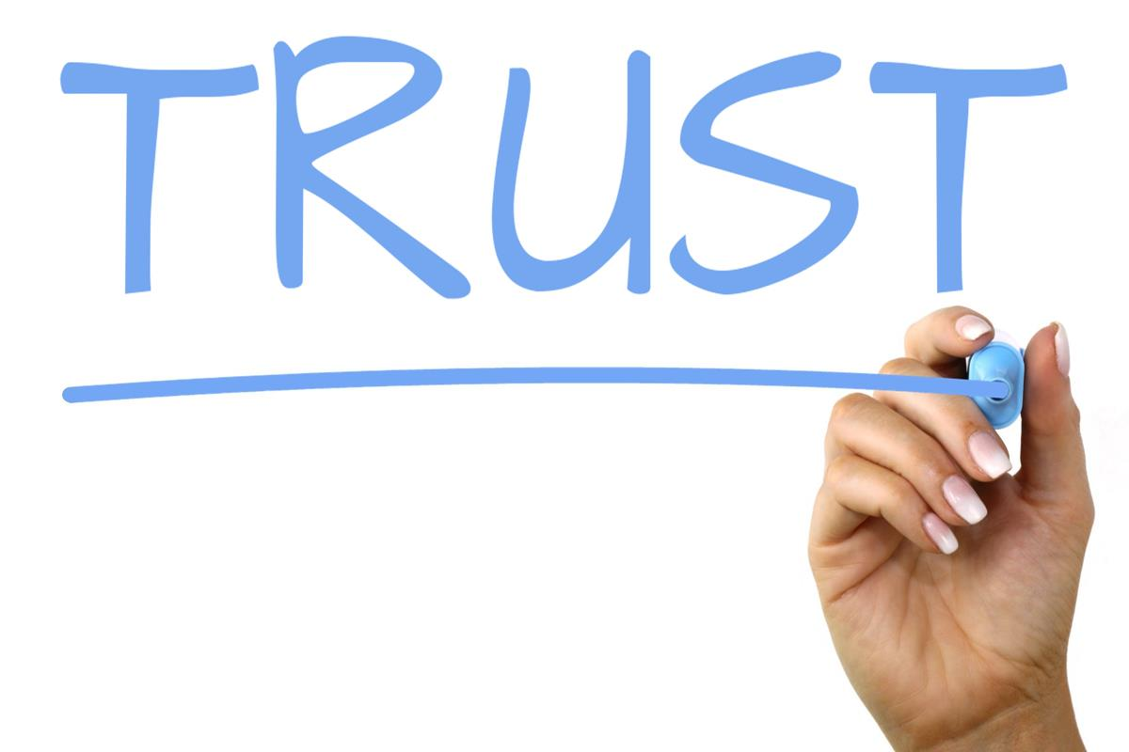
strategic planning objectives
increase trust between probation and substance abuse treatment providers
improve referral process and information sharing

Slide 31
strategic planning objectives
staff training
cross-training
improve interagency communication & collaboration
  e.g. releases of information, streamlined referral process
identify additional funding streams
develop shared standards
  e.g. monitoring medication compliance
Notes:
*staff training: POs did not know enough about MAT; brought in UA School of Pharmacy & MAT tx providers
*cross training: MAT provider agency coming in to discuss their services (how to access, intake process, etc.)
*communication: change referral process to make it more clear when an MAT referral was being sought vs. tx as usual
*additional funding streams: tribal for their AI/AN, px assistance programs, etc.
MATICCE PEC needs assessment & strategic plan: POs don’t know enough about MAT (cross training), POs don’t know where to refer (provider brochure), tx agency didn’t always know if referral was for MAT or other services (changed referral process), some non-AHCCCS eligible probationers couldn’t afford MAT (patient assistance program)

Slide 32
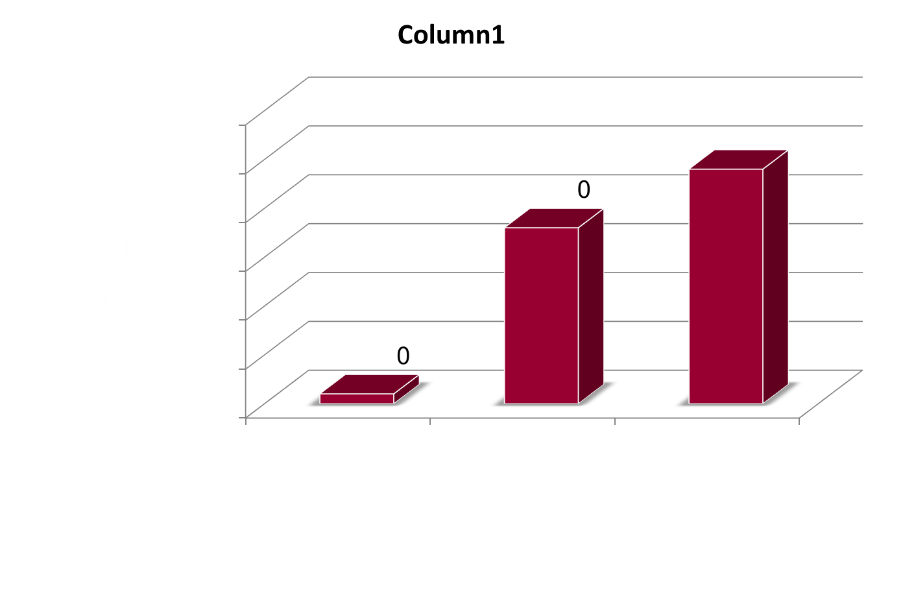
MAT referrals

Slide 33
Facilitating Group Decision Making
Establishment and clarity of decision-making rules and process are essential!
Clarity of the absolute “musts” and “must nots” from each agency
Executive leadership endorsement and lines of decision making with change team

Slide 34
Techniques for Facilitating Team Decision Making
Nominal Group Technique
Consensus Decision Making
Fist to Five

Slide 35
Techniques for Facilitating Group Information Gathering
Walk-Throughs
Flowcharting
SWOT Analysis

Slide 36
Walk Throughs Defined
Purposeful, structured passage through each layer of one’s agency/organization from the perspective of the consumer (this might include waiting in a waiting room, taking part in an intake, etc.), utilizing observations to make suggestions for improved practice.

Slide 37
Questions to Ask in a Walk Through
how does the process feel (from the perspective of the consumer)?
how much time is required for each step (e.g. waiting in the lobby, intake assessment, etc.)?
is there value in each step?
what was surprising?
what were strengths in the system?
what should be improved upon?

Slide 38
Flowcharting
Visual representation/ roadmap of the path a consumer takes through the multiple steps in accessing treatment. denoting spots in which key decisions and processes occur.

Slide 39
SWOT Analysis
Strengths, Weaknesses, Opportunities, and Threats (SWOT) analyses are commonly used in strategic planning processes to evaluate the barriers and facilitators agencies might encounter when attempting to implement a new change.
how can you accentuate your existing strengths?
how can you minimize or resolve your weaknesses?
how can you capitalize on opportunities?
how can you plan for or offset potential threats?

Slide 40
Developing Strategic Plans for Implementation & Process Improvement
process improvement planning
identify goals
develop objectives
determine action steps
action steps:
who?
what? when? where? when?
how?
measurement:
evidence of completion & level of success
document level of success in goal attainment

Slide 41
part 3: opportunities to develop agency change teams

Slide 42
PSATTC Change Team
Facilitation Academy
3 year regional initiative
Targeting agencies and systems that are at the ‘readiness stage’ of change
3 – day free, in person intensive training academy on change team facilitation skills and strategies
Selective enrollment in post-academy virtual ‘facilitation community of practice’
Notes:
Cross trainings and walkthroughs - many commented were most helpful because they got to really understand what each agency went through with clients, and developed a shared understanding of the tools and processes

Slide 43
Targeted Clinical Practice Areas
Medication Assisted Treatment: Implementation or enhancement in your agency’s use of specific medications, coupled with counseling, to treat opiate withdrawal and sobriety
Digital Health Technologies: Implementation or expansion of use of app- and web-based platforms to deliver clinical/recovery services
Motivational Interviewing: Implementation or enhancement in your agency’s clinicians’ use of Motivational Interviewing in their patient interactions.
ASAM Patient Placement Criteria: Implementation or enhancement in your agency’s use of the Patient Placement Criteria of the American Society of Addiction Medicine as part of your agency’s patient intake and assessment processes.

Slide 44
Application and Logistics
Tuesday, January 22, 2019 – Thursday, January 24, 2019
Joan Palevsky Center for the Future of Los Angeles
Application review will occur on rolling basis
November 30-December 17
with all applicants notified not latter than December 18, 2018.
To apply, go to:
http://www.psattc.org
Application must include a CV/resume and a letter of commitment from an agency executive.

Slide 45
Thank you!
Michael Shafer
Co-Investigator, Pacific Southwest ATTC
Professor, School of Social Work
Watts College of Public Service & Community Solutions
Arizona State University
Michael.Shafer@asu.edu

